Slide 1
Restaurant Closures: Project Update
Cole Smith

Slide 2
Recap
Objective is to predict
whether or not a restaurant will close within a given period of time
Based upon factors like
Health Violations (type, frequency), Location (demographics, income), Cuisine Type, Restaurant Type (restaurants vs. sidewalk cafes), and Economic Trends (DJIA, VIX)

Slide 3

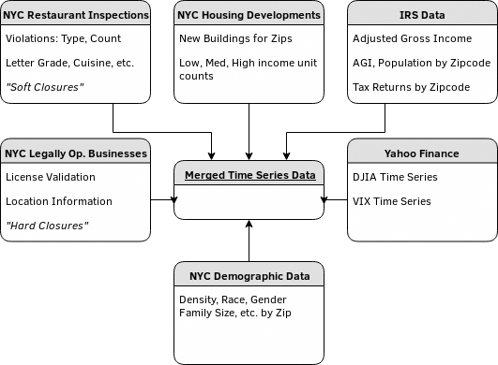


Data Sources
Each row is a point in time for a zip code

Slide 4
Data Merging
No universal identifier for restaurants between data sets
Fuzzy Joining found infeasible due to restaurants using either legal or DBA name in data set.
Common keys are therefore only zip code, year, and month
Closed restaurants not represented in Inspections data set

Slide 5
Rethinking The Problem
Two Types of Closures
  Hard Closures: License expired and not renewed, cannot legally operate – presumably voluntary
  Soft Closures: Health Inspection shutdown, may re-open at some point – presumably involuntary
Hard closures appear related to soft closures on monthly aggregations
Regression can be performed on All Closures while Classification can be performed on Soft Closures

Slide 6
Data Preparation
Data is set up to be analyzed in two ways:
Restaurant-row format
(Restaurant Inspection Data Set)
Monthly Zip-row format
(Master DataFrame)

Slide 7
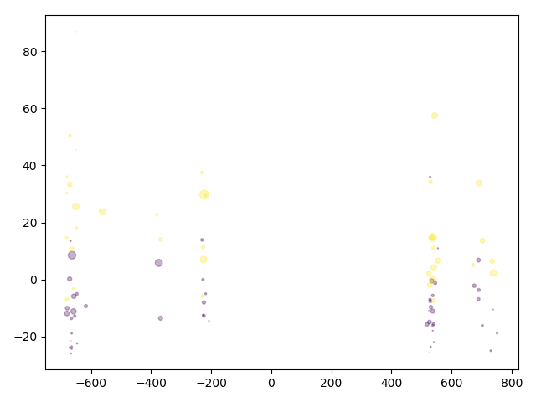
Data Exploration: Restaurant Inspection Data Set
Data extremely imbalanced (0.5% closure rate)
Estimators perform poorly
Bootstrap Sampling, Downsampling: Estimators perform well but over-fit (lack of specificity)

Slide 8
Fixing Imbalance
Waiting until NYC releases new data set…
Netted extra 750 closures over 2 months
New total closure rate: 3.2% of sampled restaurants

Slide 9
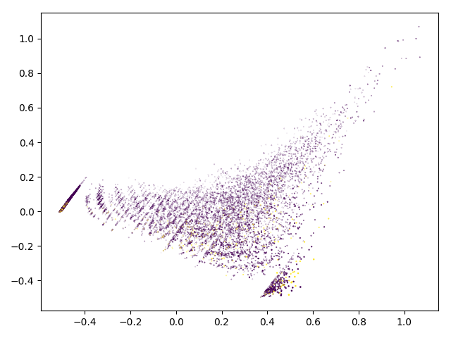
Restaurant Inspections: PCA Visualization

Slide 10
Classification Performance (n=3,476)
Gradient Boosting Machine
  F1: 0.51
  Cohen Kappa: 0.38
K-Nearest Neighbors
  F1: 0.12
  Cohen Kappa: 0.07
Neural Network
  F1: 0.46
  Cohen Kappa: 0.38
(Positivity Rate Bootstrapped to 25%)
Top Features by RFE-CV and GBM
Score
Grade
Total Inspections
Violation Count
Critical Violations

Slide 11
Data Exploration: Master Data Set
Includes all previous data plus
  Economic Trends
  Demographic
  Adjusted Gross Income
Time series: Zip codes in monthly increments
  Data was treated independent of time, however

Slide 12
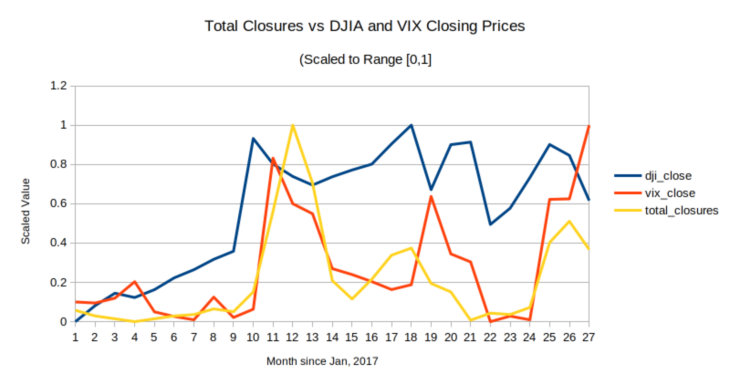
Master Data Set Over Time

Slide 13
Master Regression Performance (n=1,550)
Gradient Boosting Machine
  Exp. Var.: 0.78
  MAE: 0.28
  R2: 0.78
Neural Network
  No convergence (R2: ~ 0.0)
Linear Regression
  Exp. Var.: 0.50
  MAE: 0.36
  R2: 0.50

Slide 14
Observations
Zip was not important
  Nor was demographic data.
Cuisine type and DJIA/VIX was important (As found by RFE/GBM)
  American
  Cafes
  Chinese
About 40% of explained variance is non-linear
Certain violations will always result in a soft closure
Soft closures can reliably model all closures

Slide 15
Future Work
Finding unique restaurant identifiers
Restaurant Inspections Data Set can be collected over time
  Points may lie on a manifold → Isomap/Spectral Embedding
Analysis of Social Media Presence

